Slide 1
Visualizing Objects in Java
better than with toString()

Slide 2
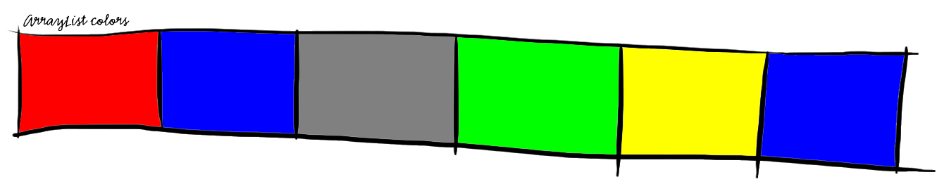
Why?
ArrayList containing some Colors
Console output (System.out.println(colors);):
[java.awt.Color[r=255,g=0,b=0], java.awt.Color[r=0,g=0,b=255], java.awt.Color[r=128,g=128,b=128], java.awt.Color[r=0,g=255,b=0], java.awt.Color[r=255,g=255,b=0], java.awt.Color[r=0,g=0,b=255]]
Possible graphical output (D.raw(colors);):

Slide 3
Use Case
ArrayList<Person> persons
Person class fields:
String name
PhoneNumber number (foreign class)
byte[] image (from .png-file)

Slide 4
Use Case
System.out.println(persons);
→ (too much confusing text)
Let’s define a drawOn()-method!

